Slide 1

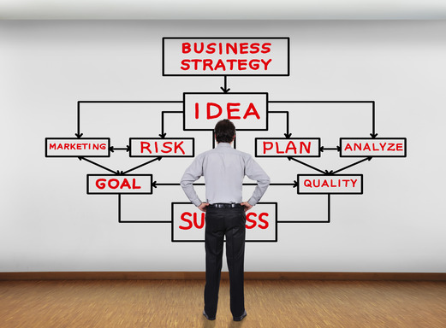
Mike Scott – Mike Scott Associates Ltd

Slide 2

Businesses (so far!)
Phase One Records
THE Group
Red Lion Pub & Restaurant
Mike Scott Associates
Amplify Referral Network

Slide 3
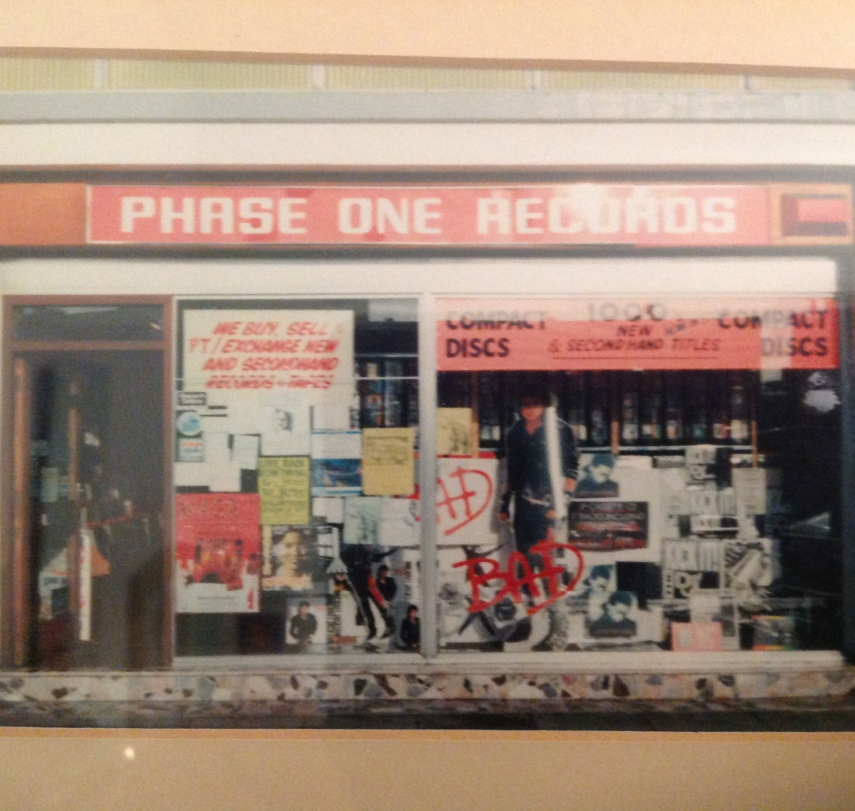

Slide 4
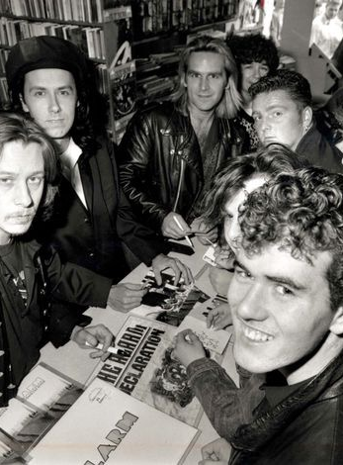


Slide 5
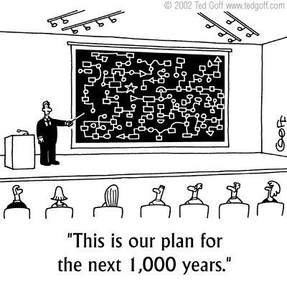
Definition – What is Strategy?
A focus on and a consideration of the longer-term view of a business and the direction it should take.
A strategy is made in advance and has a purpose for the future, it will specify choices, it will be a unified plan, comprehensive and integrated into the purpose of the business and determine the overall direction of an organisation.

Slide 6

What are we trying to achieve?
As people involved in business together, we have to understand and agree what success looks like – so we are clear on what we want to achieve.
Goals, targets, vision, timescales etc.
Once we have this, our strategy is crucial in determining long-term success.

Slide 7
Our Strategy
Be the best Record Shop in North Wales
Create an environment where people feel like they belong to a club - a society of music lovers.
Add real value by providing services our competitors cannot match.
Remember people and what they like.
Become a Chart Return Shop.
Enjoy it every day. If we do, they will!

Slide 8
Who has ever been on Holiday?
Where are we going?
How are we going to get there?
What do we need?
What do we have already?
When will we get there?

Slide 9

Can you inspire others?
Believe in your company vision. Having and believing in your company’s core values will invite others to adopt a similar clarity of mind and direction.
Make others feel like part of the team. Building a sense of belonging in and out of the workplace is a crucial aspect of inspiring your colleagues and all the other stakeholders.

Slide 10
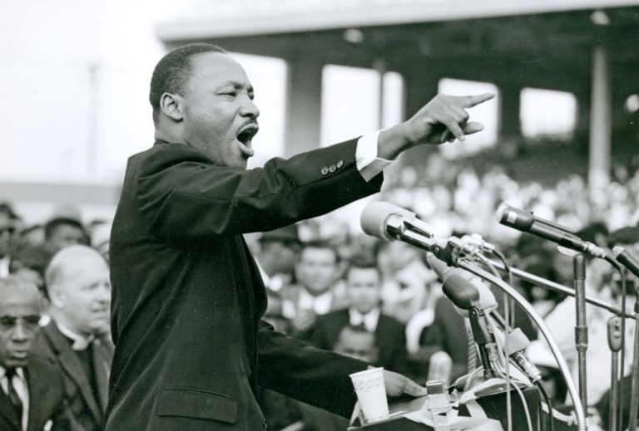
Inspirational Strategic Narrative
One of the greatest strategic leadership narratives on record is the one Martin Luther King Jr. gave on Aug. 28, 1963, during the March on Washington – the renowned "I Have a Dream" speech.
His speech described his aims, his motivation, his vision and contained a call to action that galvanized a nation.
A little-known fact is that the "dream" part was almost excluded, but for Mahalia Jackson

Slide 11
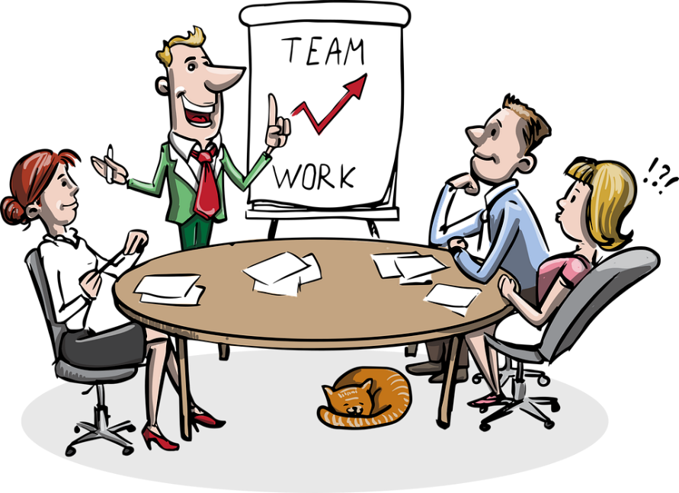
4 Lessons in Strategic Communication
These lessons are highly applicable to an organisation in any sector:
Don’t rely on written communication
Make messages clear and relevant (people need to see the future)
Communication is two-way, or its just information
Tap into your team’s vision – what do they actually see – if anything?

Slide 12

Strategy is a waste of time!
Is strategic planning just a waste of time? According to ex-IBM CEO Louis Gerstner, many CEOs don't see any bottom-line impact. Therefore, they consider strategic planning to be merely an academic exercise that offers no tangible, real-world results.
But Gerstner laid the blame on these executives themselves. What they called strategic planning was, in his view, little more than an extrapolation of short-term financial projections.

Slide 13

Scary Numbers!
"Success is a lousy teacher. It seduces smart people into thinking they can't lose." - Bill Gates
Businesses doing well don’t think they need strategic direction
Only 22% of UK employees believe their leaders have a clear direction
Only 15% of UK employees think their leaders make them feel enthusiastic about the future
Source: Gallup Research

Slide 14
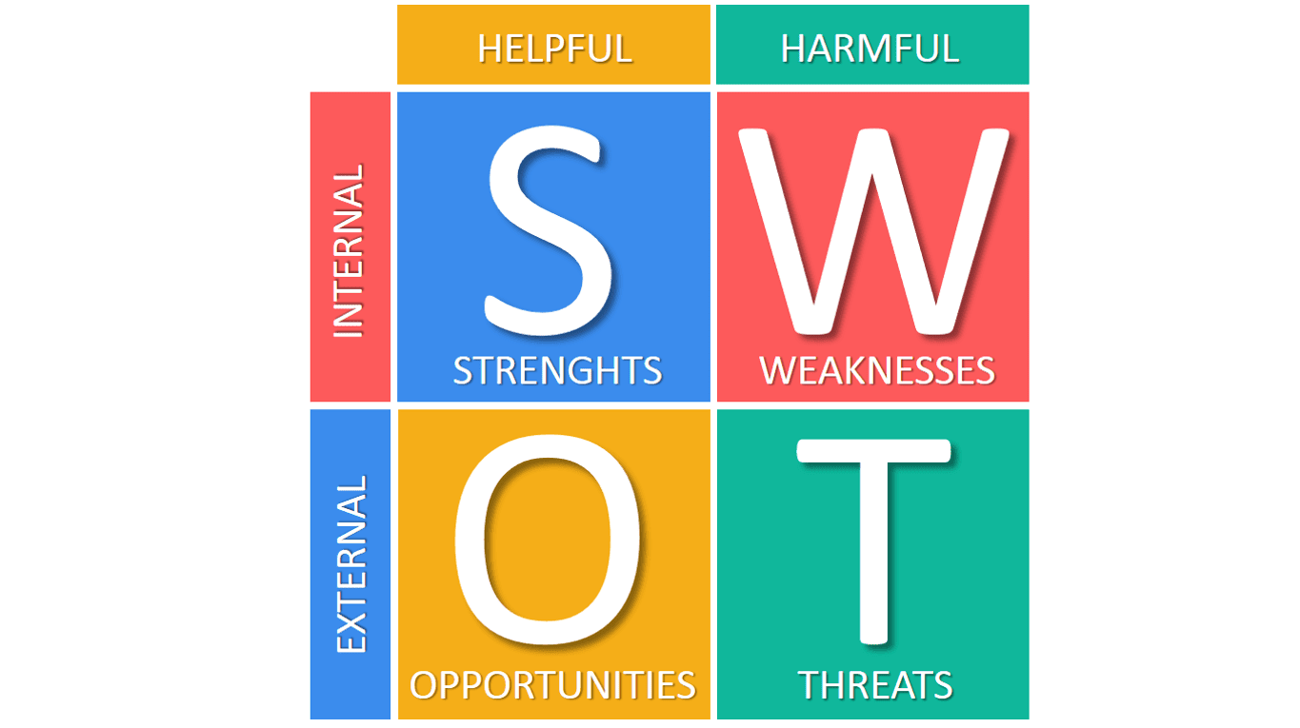
Do we know our business?

Slide 15


Do we know theirs?
Who are our competitors?
What are they good at?
Where are the gaps?
How much do they care?
What makes them stand out (or not)?
……………..Can we handle it and can we afford it!

Slide 16
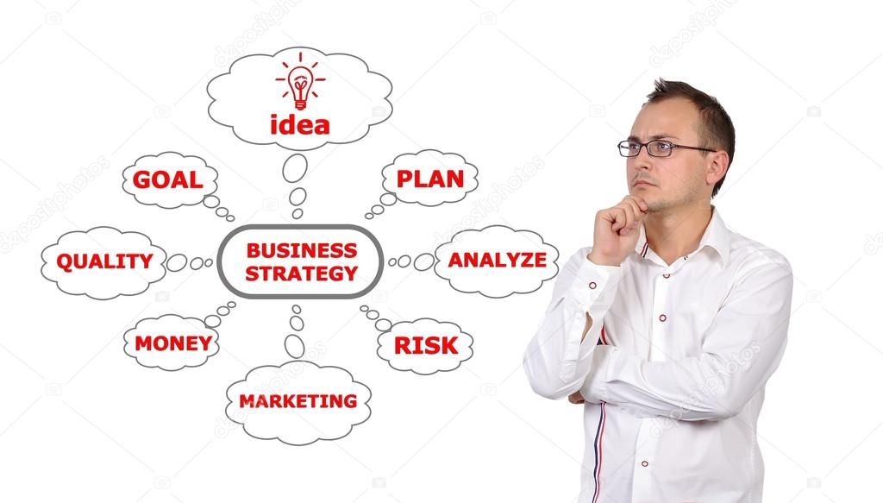
The Road Map Approach

Slide 17
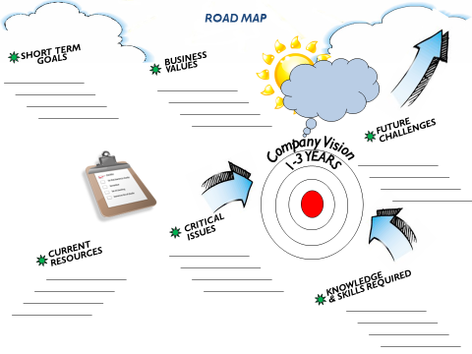

Slide 18
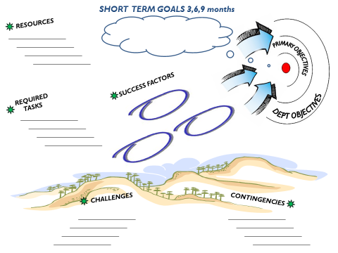


Slide 19
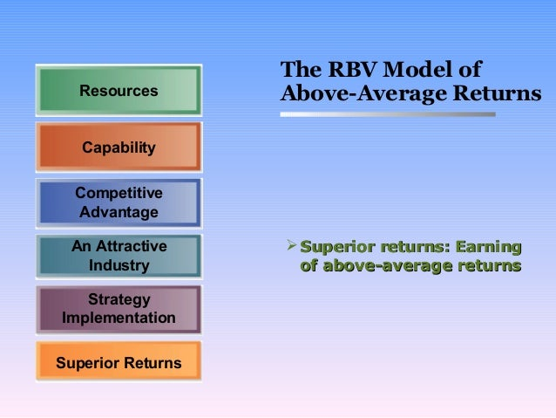

Slide 20

Strategic Customer Foresight
The bigger picture for customers outside of your current offering
How the world is changing and how potential future events may affect customers’ needs
How you can bring foresight into the awareness of everyone in the organisation
If we did this successfully, where would it potentially put our business, in terms of the market in which we operate?

Slide 21
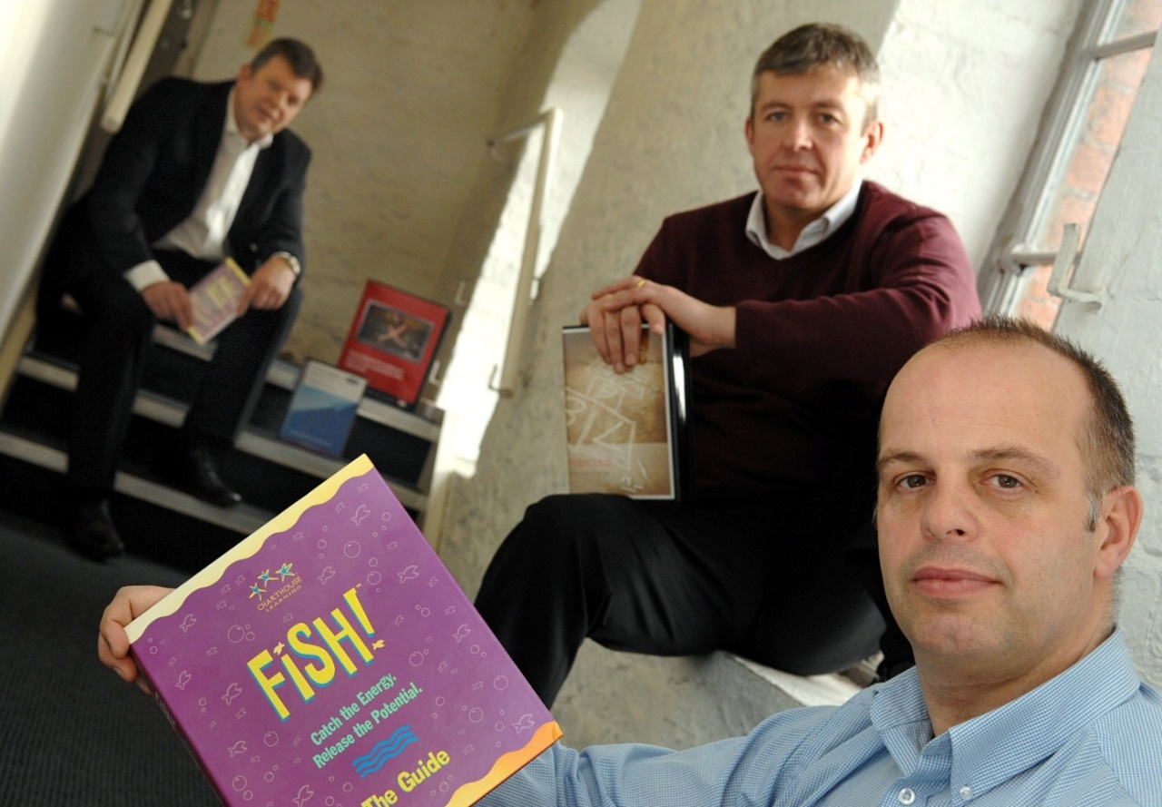
THE Group Ltd
Vision: Premier, commercial Learning & Development Company in Wales
Mission: Simple to understand, easy to implement, Business Improvement Skills
Strategy: A three tier service
First: Commercial contracts directly with business customers
Second: Win Welsh Government Contracts and deliver a fantastic service
Third: Underpin the support with access to Learning Resources

Slide 22
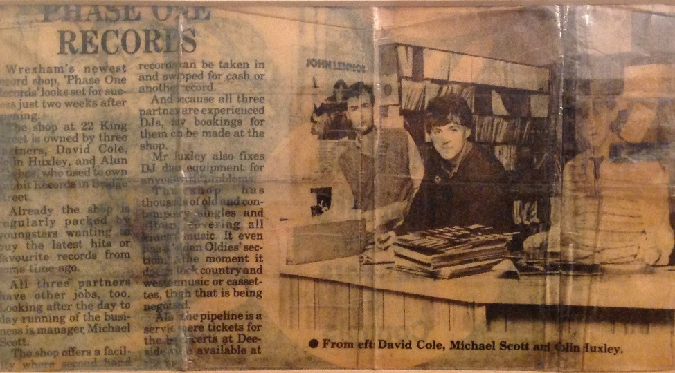
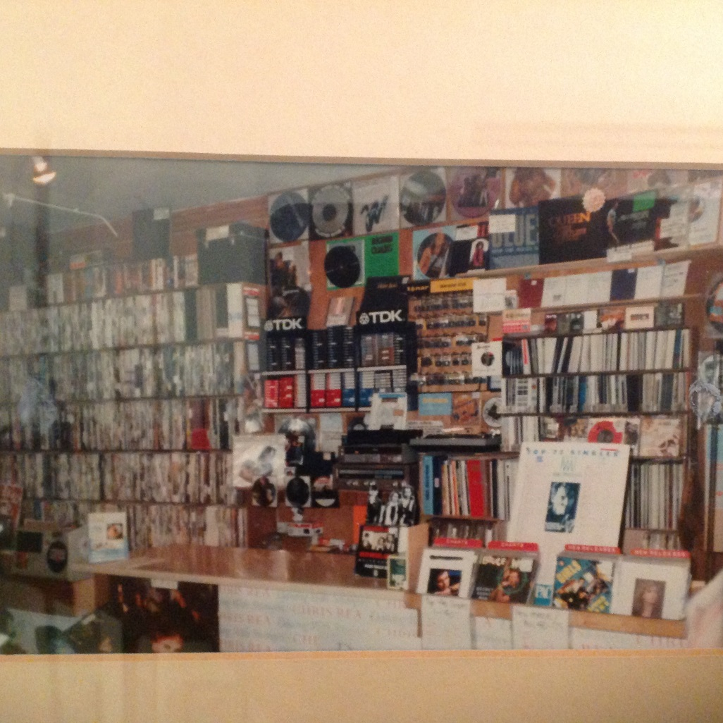
Where it all started!

Slide 23
Phase One Records
Chart Records
Widest range of stock availability
Off the Mainstream, Independent Music
Second-hand Records
‘If we haven’t got it, we will get it’
Disco Agency
Concert Tickets
T-Shirts & Posters
Specialist Areas – John Peel Corner
Vision: The best independent Record Shop in North Wales
Mission: Provide a better range of services than the competition and deliver those services brilliantly
Strategy: Create an ‘I’m in the club’ mentality. Underpinned by employees who are passionate, really know their stuff and provide great customer service

Slide 24

….any final Questions?

